Slide 1

2026 01-08 + 09-12 FC
RESULTS

Slide 2
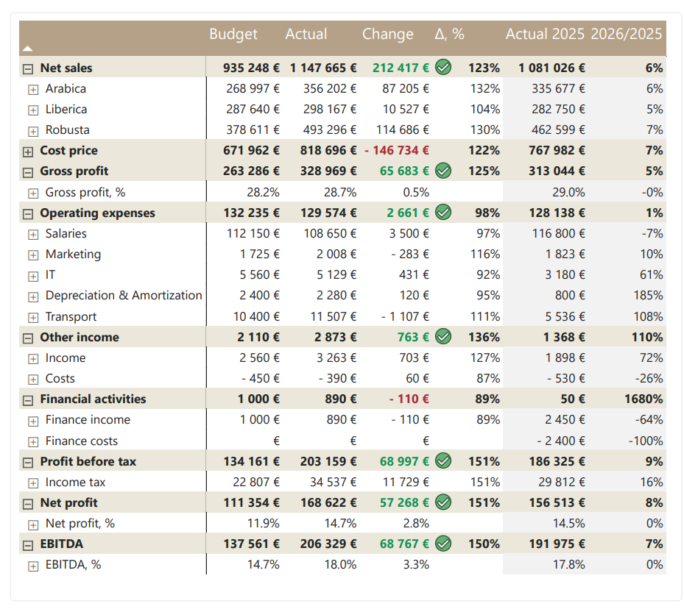

P&L 2026 01-08
Comments
Net sales showed strong results, exceeding budget by 23% and showed 6% growth compared to the same period last year.
Gross profit margin is 0.5% higher than expected although slightly lower than 2025 level.
Net profit increased by 8% YoY (+57 268 €) with profit margin is 2.8% above budget.

Slide 3
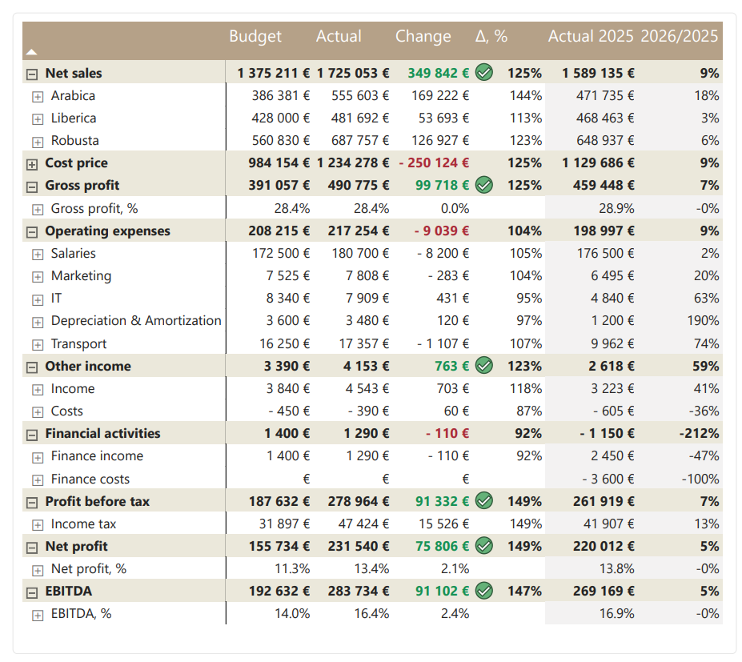
P&L 2026 01-08 + 09-12 FC
Comments
Full year net sales are forecast at € 1,7 milion, 25% above budget and 9% higher than 2025.
Gross profit is expected to reach € 0,49 milion (+7% YoY) with 28,4% margin, which is exactly as budget.
Net profit is expected to be € 231 540, 49% over budget and 5% higher YoY, with net profit margin 2,1% above budget.

Slide 4
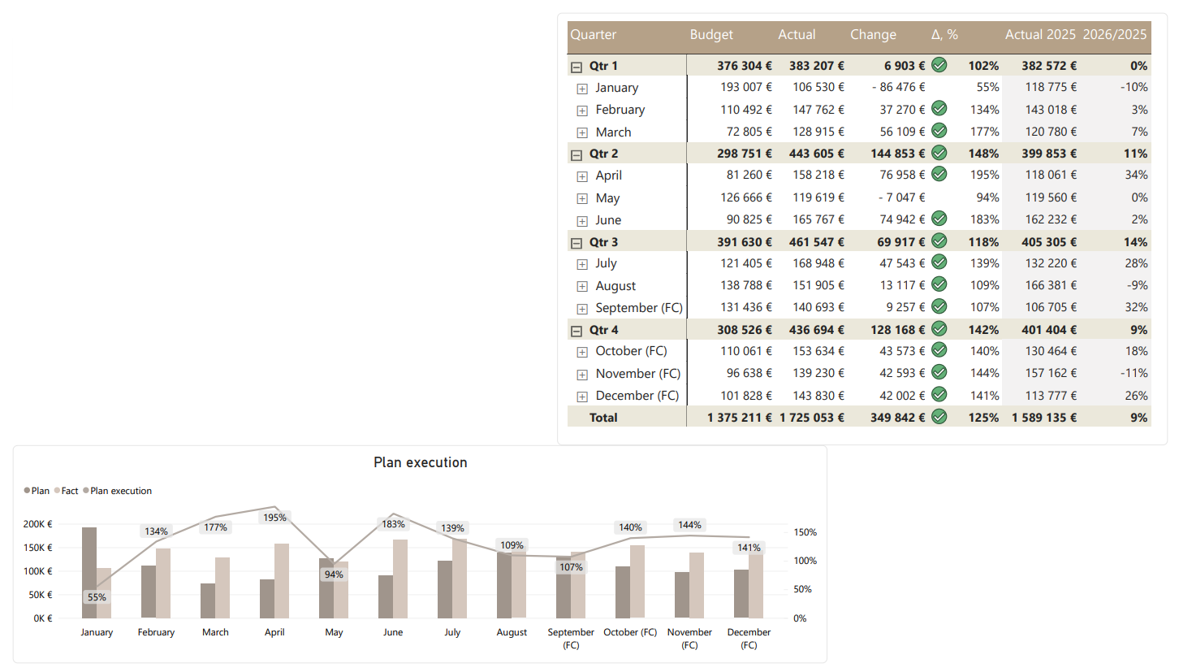
NET SALES 2026 01-08 + 09-12 FC
Comments
Following a slower start to the year, net sales have gained momentum, with only January and May falling below budget.
A strong end of the year is expected, with Q4 sales forecast to exceed budget by 42%.

Slide 5
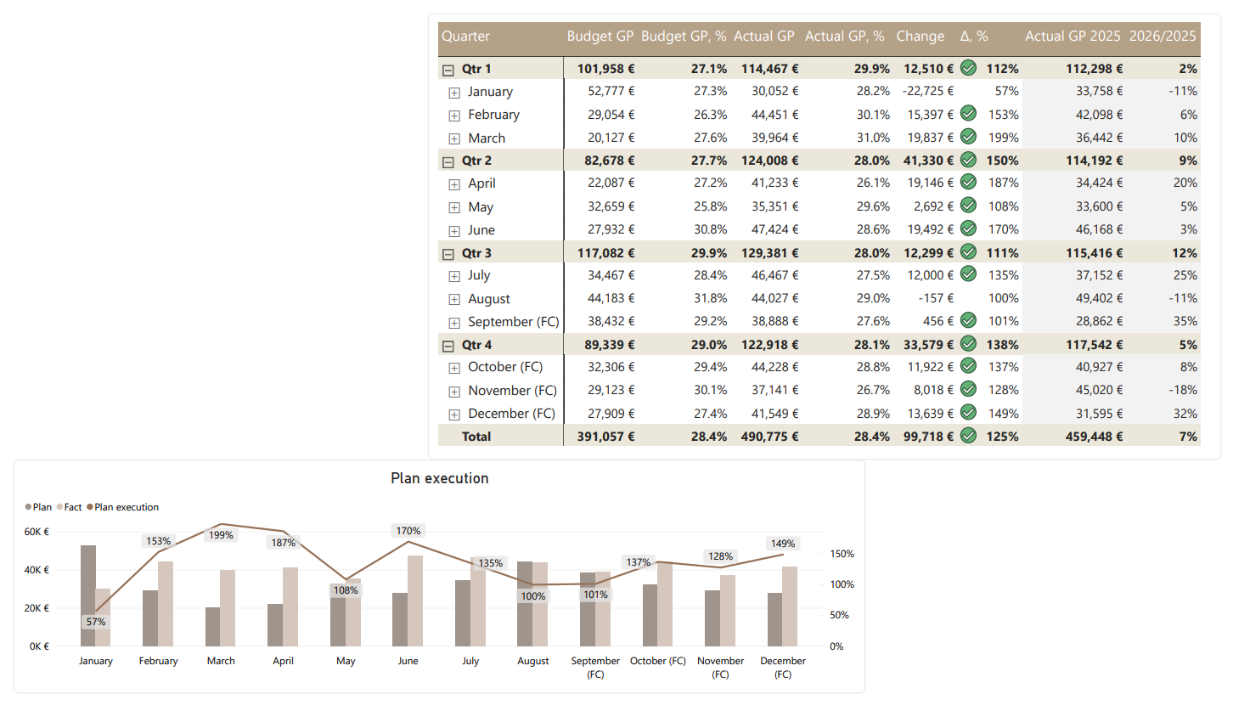
GROSS PROFIT 2026 01-08 + 09-12 FC
Comments
Gross profit is higher than expected, driven by higher sales volumes, while the gross margin remains in line with plan.

Slide 6
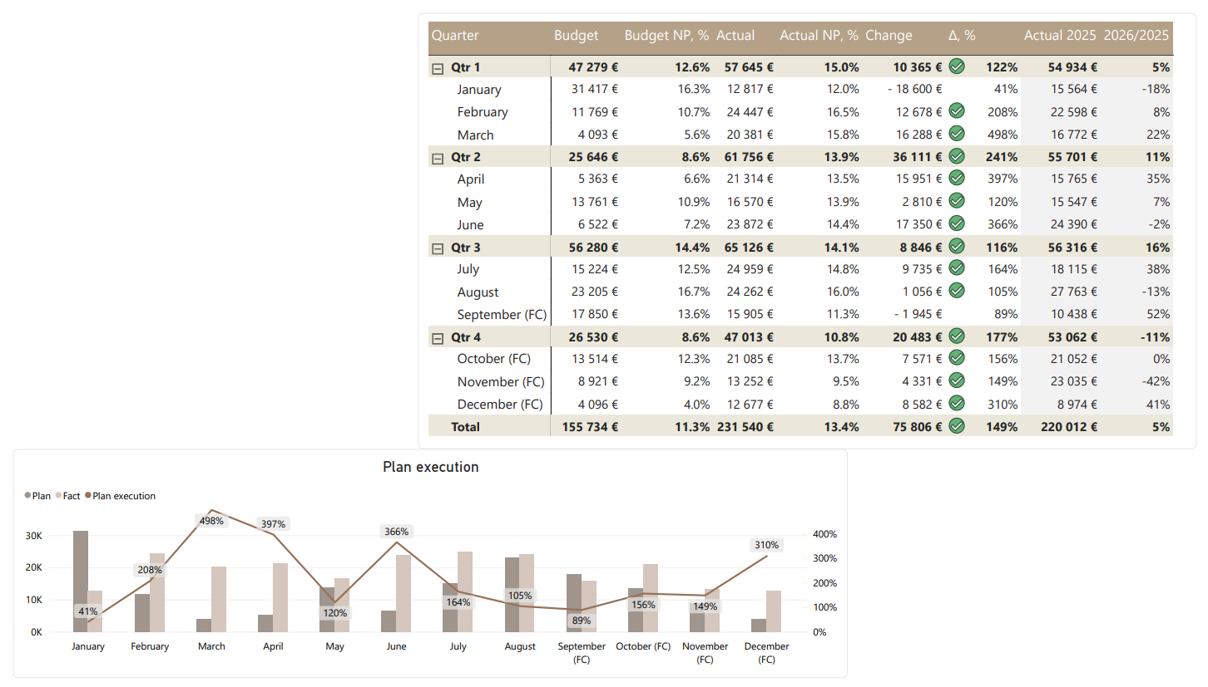
NET PROFIT 2026 01-08 + 09-12 FC
Comments
Q4 net profit is forecast to exceed budget by 77%, but is expected to be 11% below Q4 2025.

Slide 7
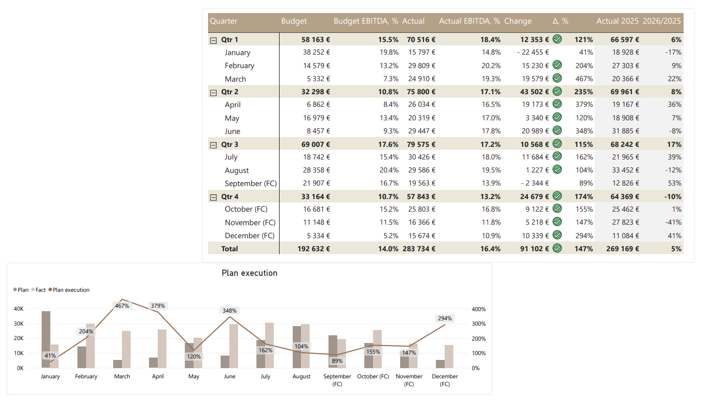
EBITDA 2026 01-08 + 09-12 FC
Comments
EBITDA is expected to reach € 283 734, 47% above budget and representing a 5% YoY increase, with the EBITDA margin 2,4% above budget.

Slide 8
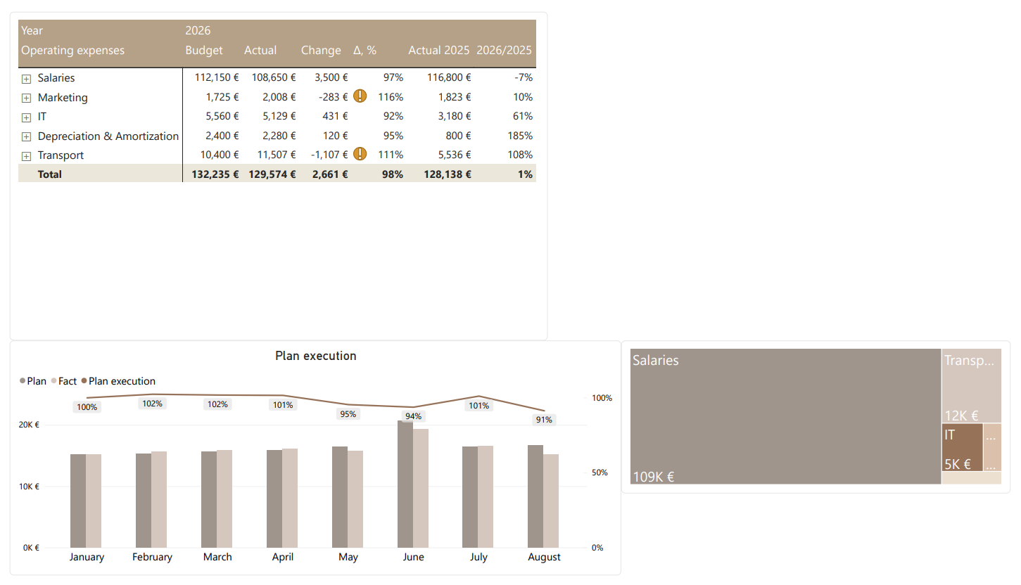
OPERATING EXPENSES 2026 01-08
Comments
Marketing expenses are slightly over budget, mainly due to higher than planned campaign and promotional costs.
Increased trasnportation expenses were driven by an unexpected increase in fuel prices.

Slide 9
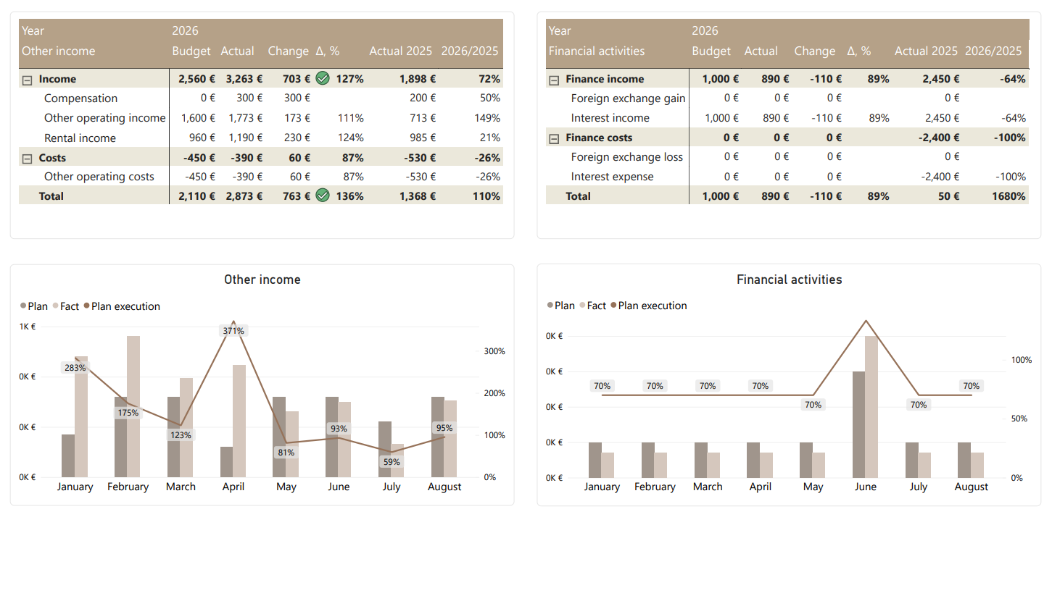
OTHER INCOME & FINANCIAL ACTIVITIES 2026 01-08

Slide 10
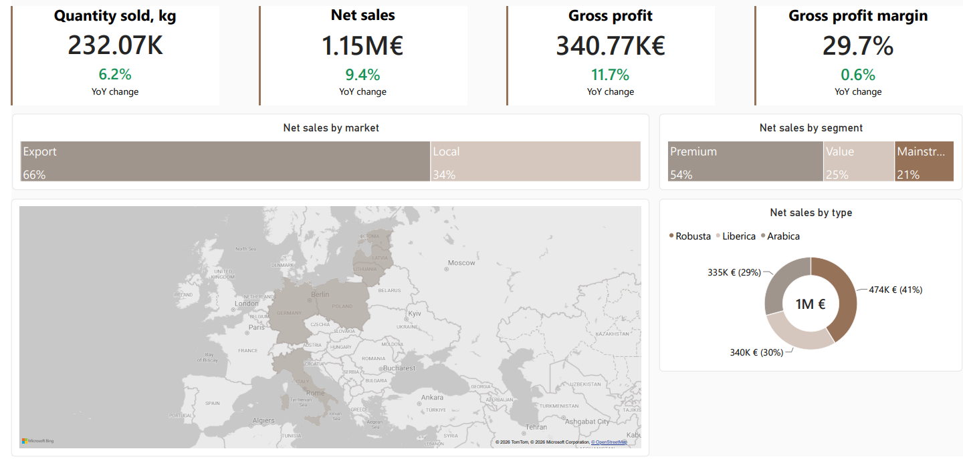
NET SALES OVERVIEW 2026 01-08

Slide 11
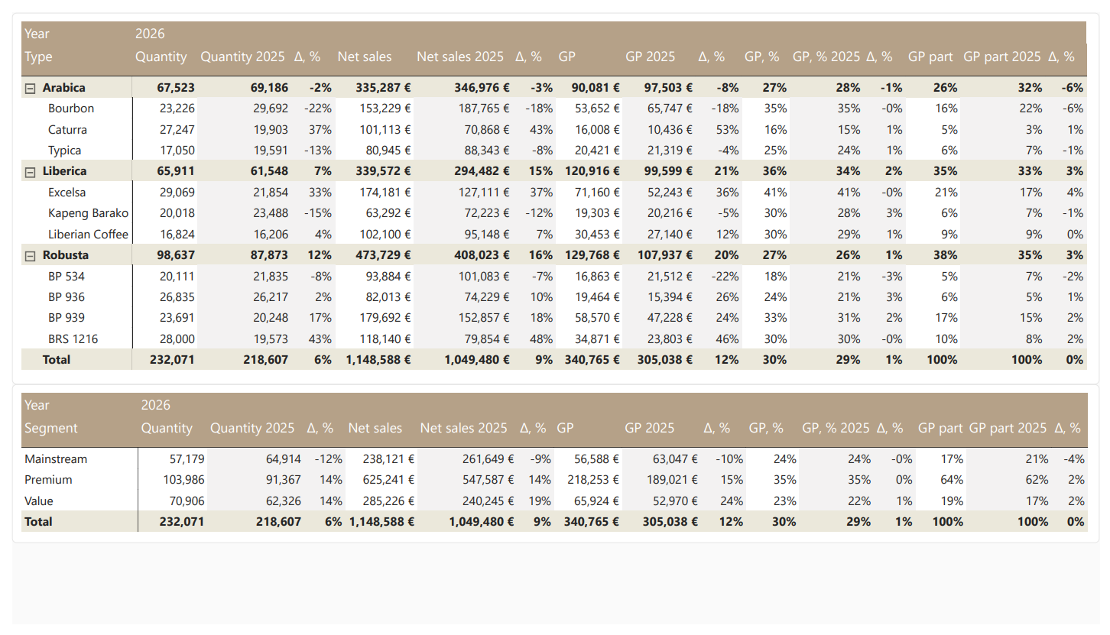
NET SALES 2026 01-08

Slide 12
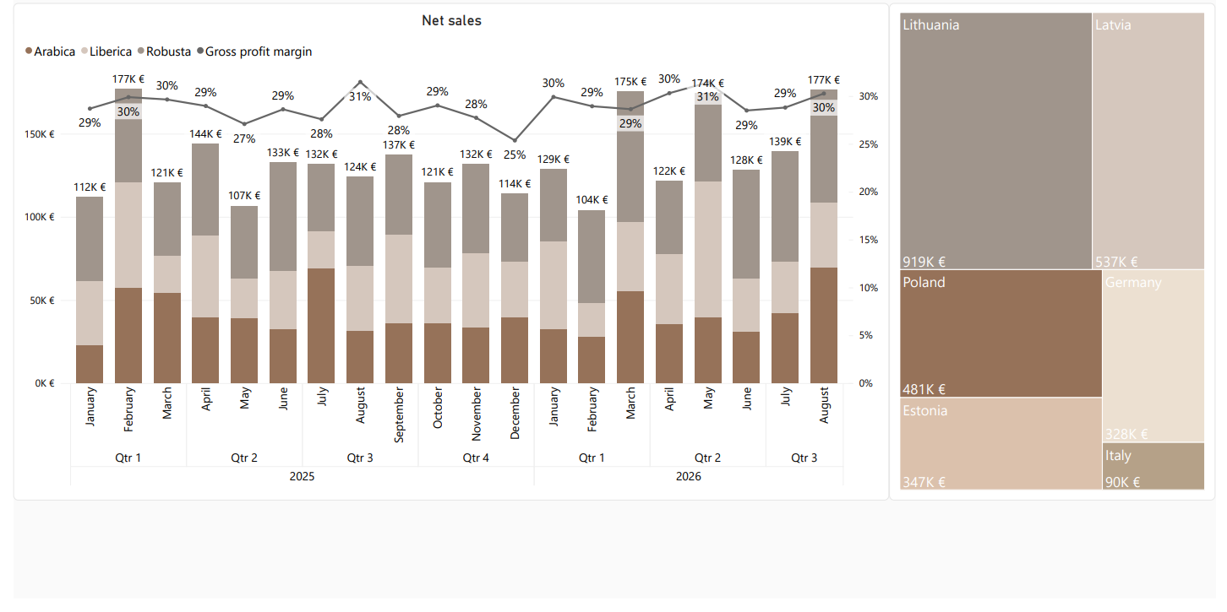
NET SALES BY DATE

Slide 13
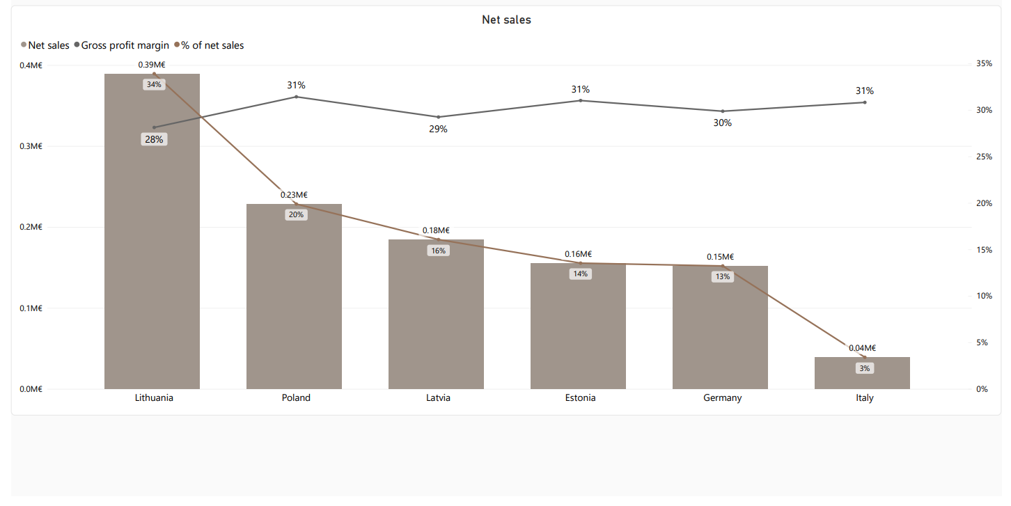
NET SALES BY COUNTRY 2026 01-08

Slide 14
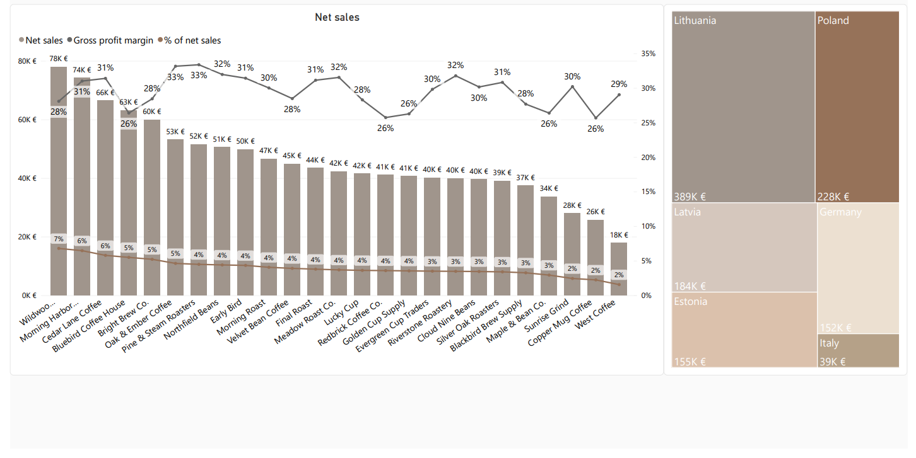
NET SALES BY CLIENT 2026 01-08

Slide 15
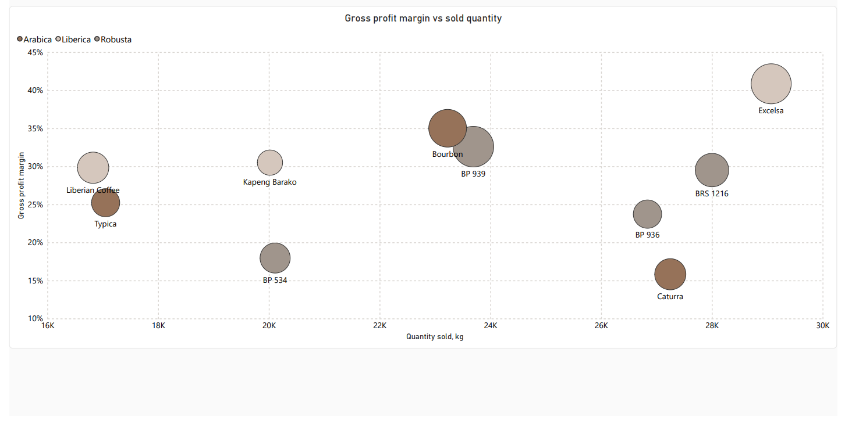
SALES OVERVIEW 2026 01-08

Slide 16
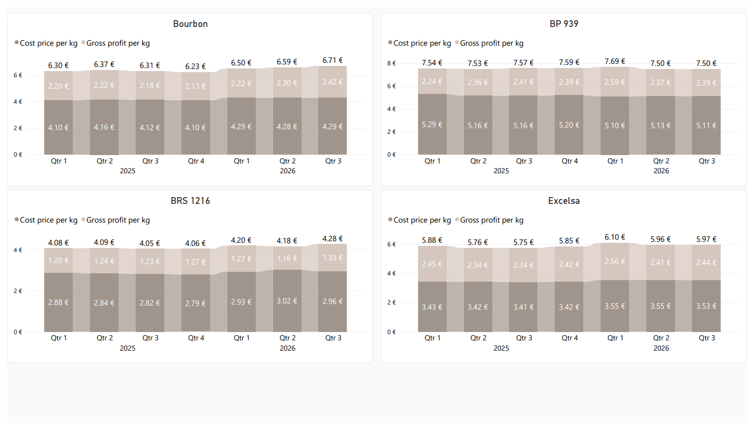
PREMIUM SEGMENT: GP AND COST PRICE

Slide 17
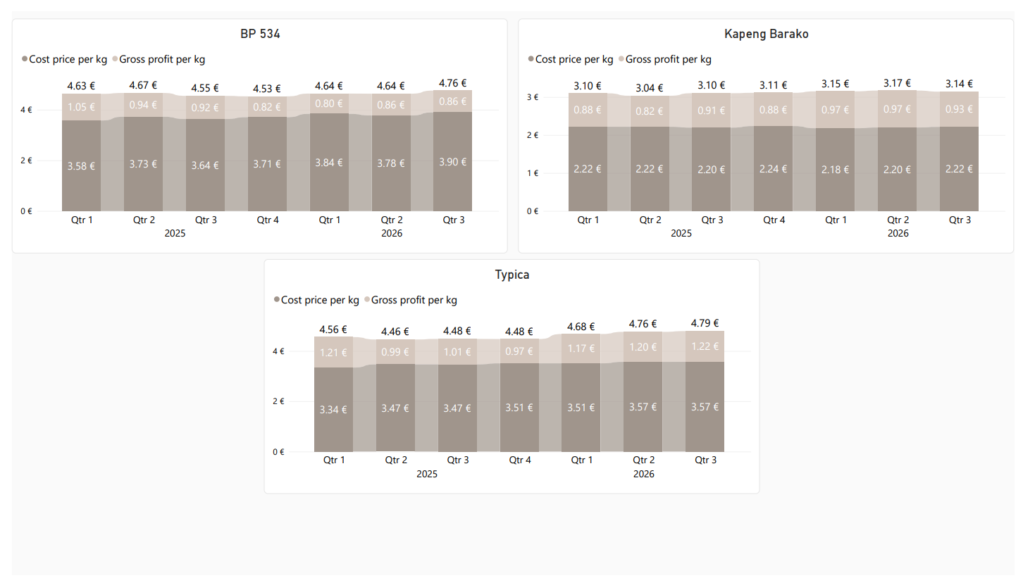
MAINSTREAM SEGMENT: GP AND COST PRICE

Slide 18
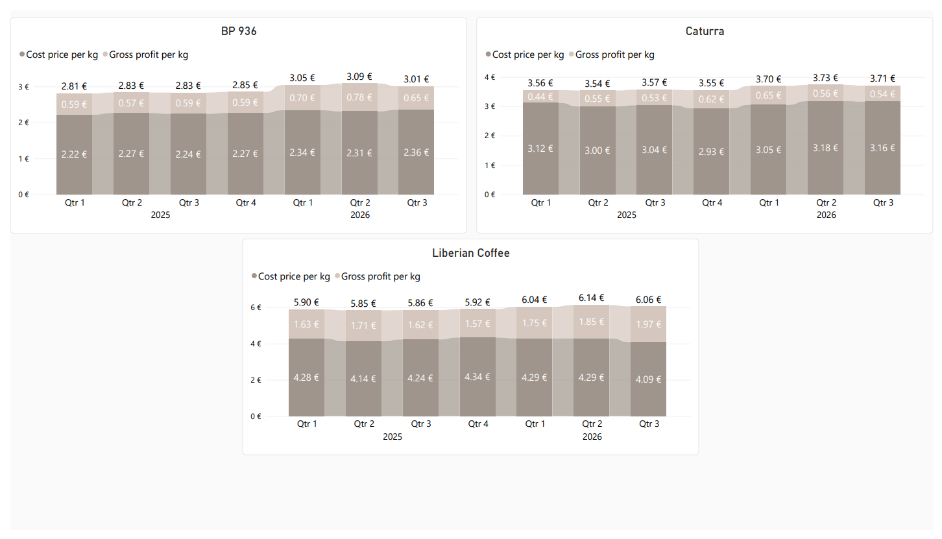
VALUE SEGMENT: GP AND COST PRICE

Slide 19
Q&A

